Slide 1
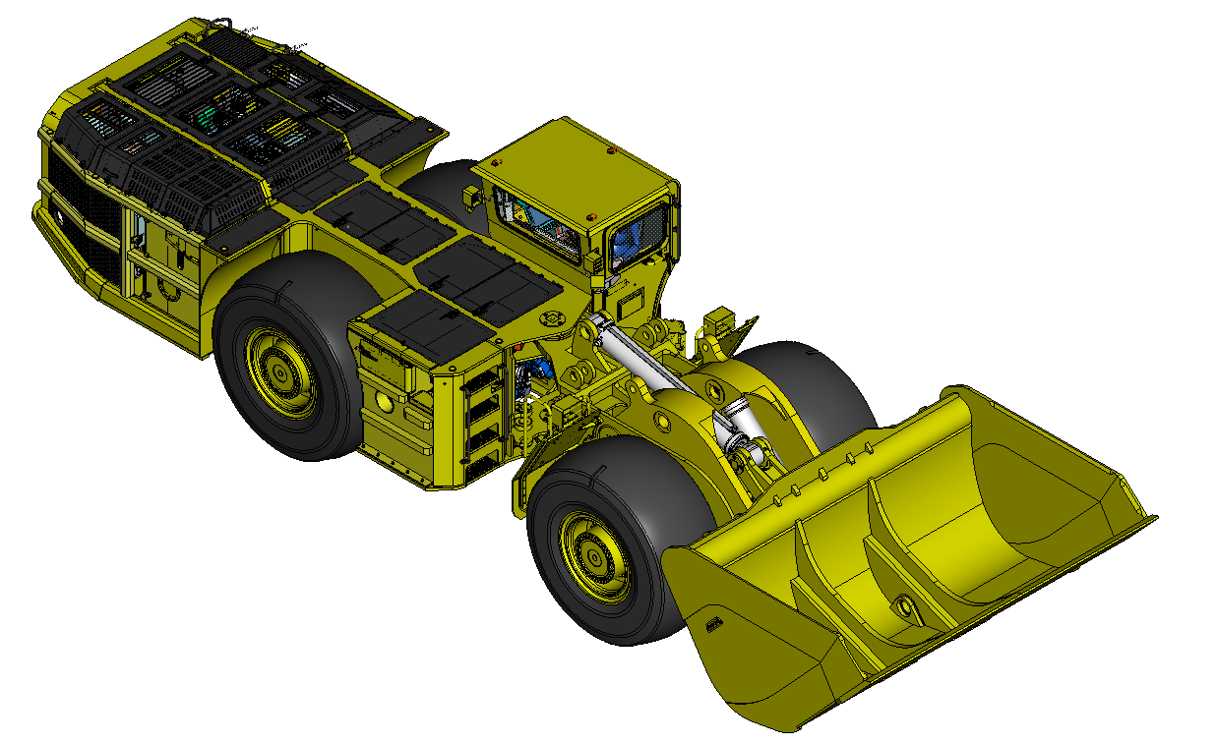
LF-19 H
Status: 2018-06-29

Slide 2
LF-19H
Table of Contents:
Page 3 General Layout
Page 4 General Layout and Main Components
Page 5 Steering Radius
Page 6-8 Kinematics of Digging
Page 9,10 Layout Drive Unit
Page 11 Layout Payload Unit
Page 12 Payload Structure Improvements
Page 13 Position Operator Cabine
Page 14 Layout Operator Cabine
Page 15 Cabine, Visual Analysis
Page 16 Cabine Interior
Page 17 New Drivers Control Desk
Page 18 Technical Specification

Slide 3
General Layout

Slide 4
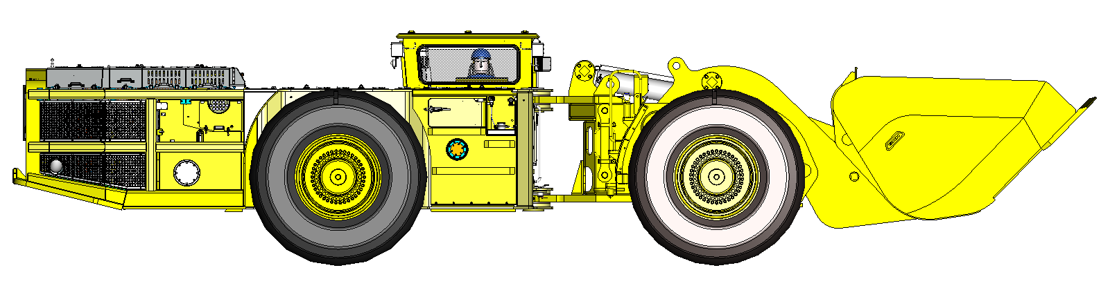
General Layout and Main Components
Drive Unit rear LF-21H
Drive Unit front LF-21H SI
Payload Unit LF-19EB
415 / 615
2650 (2850)
2235
1932
2201
857
14°
10°
560
540
341
3791
2275
2135
4398
12599

Slide 5
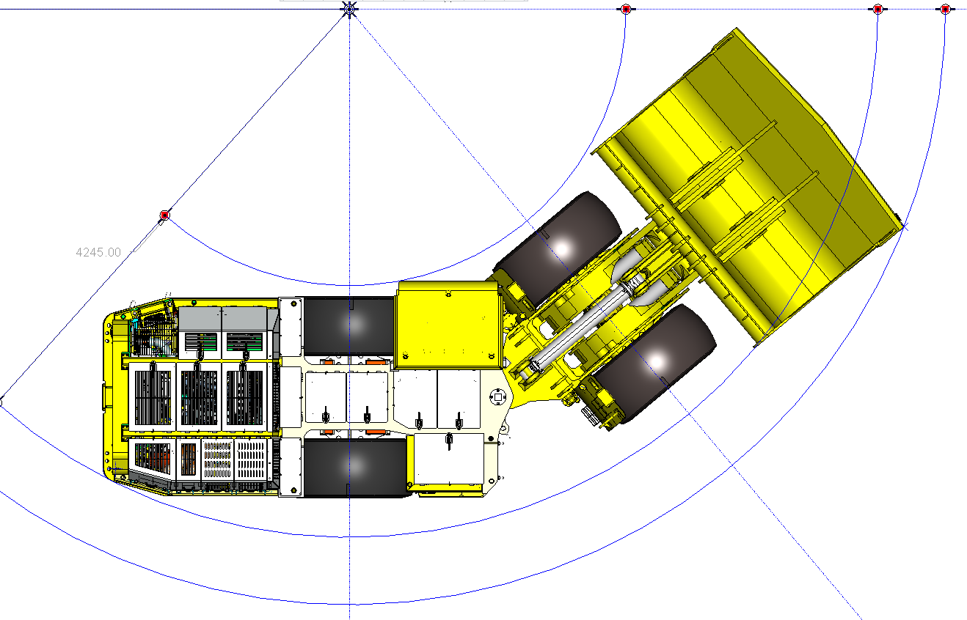
Steering Radius
Turning Angle RH & LH: 40°
Bucket Capacity (SAE): 12,9 m³
Axle D111 P447/PL545-NLB-FS (Co. Kessler)
Tyres 875/65 R 33 (Co. Goodyear)
4000
40°
R 4245
2260
3327
3090
R 8110
R 9145

Slide 6
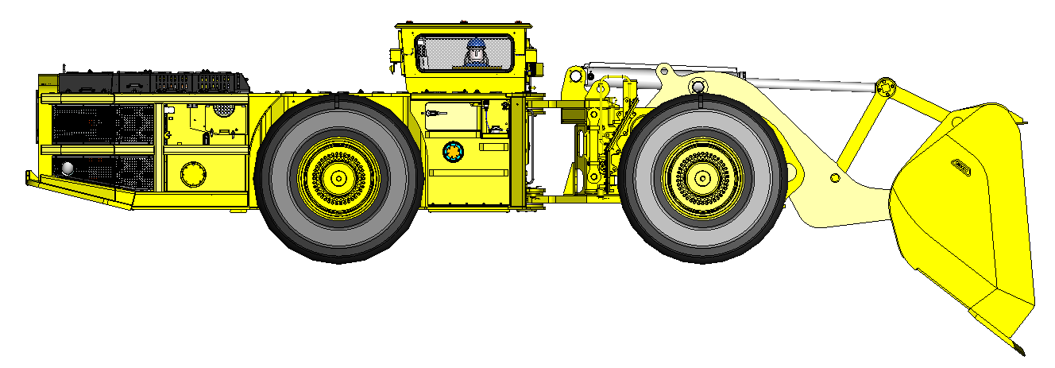
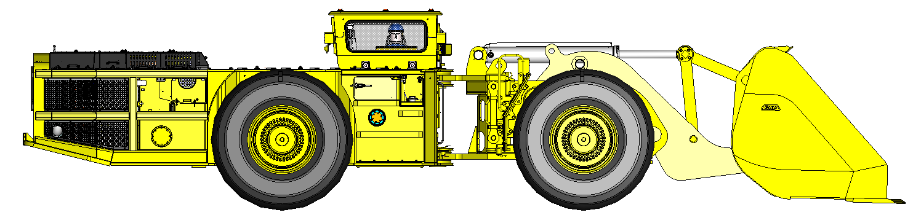
Kinematics of Digging
1856
540
1217
38°
12096
12224
2311
540
1,5°
12902

Slide 7
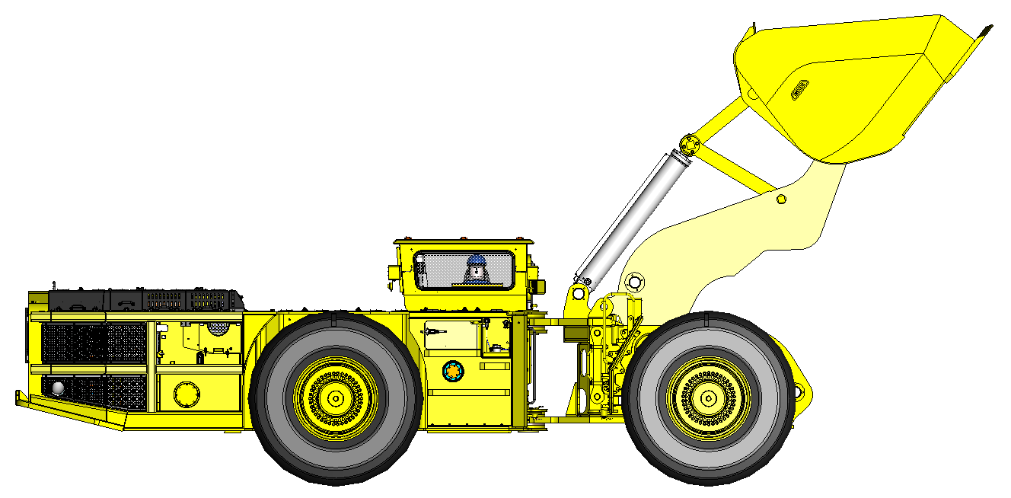
Kinematics of Digging
5347
5476
52°
540
11566

Slide 8
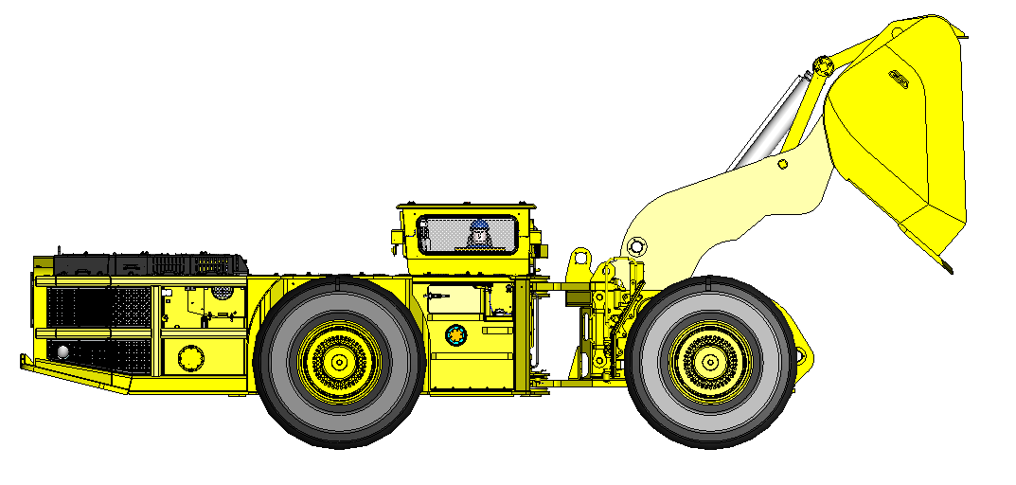
Kinematics of Digging
5069
41°
1978
540
11076
11268

Slide 9
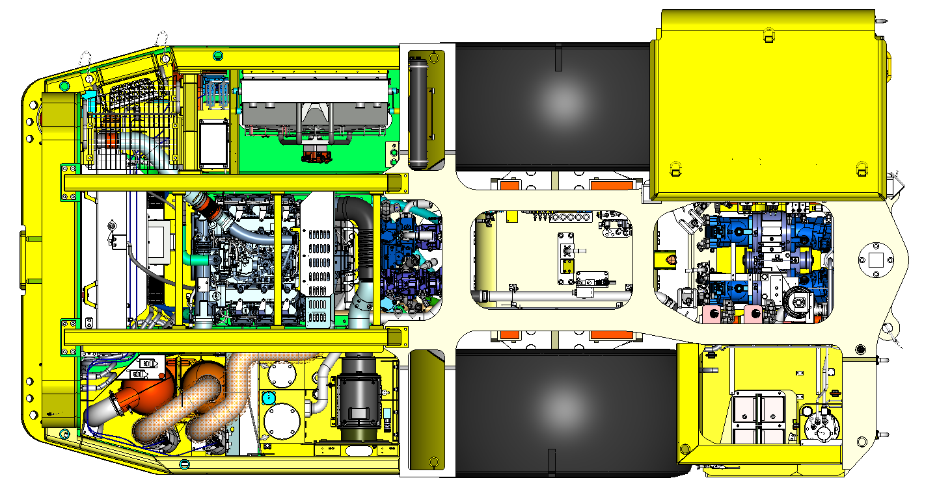
Layout Drive Unit
Ladder
Urea Tank
Engine
Hydraulic Cooler
Brake Accumulator
Pump Transfer Gear
Axle Transfer Gear
Cooler
Ladder
Exhaust System
Hydraulic Tank
Air Filter
Swing Axle
Fuel Tank
Drive Unit (Layout „Sigmundshall“)

Slide 10
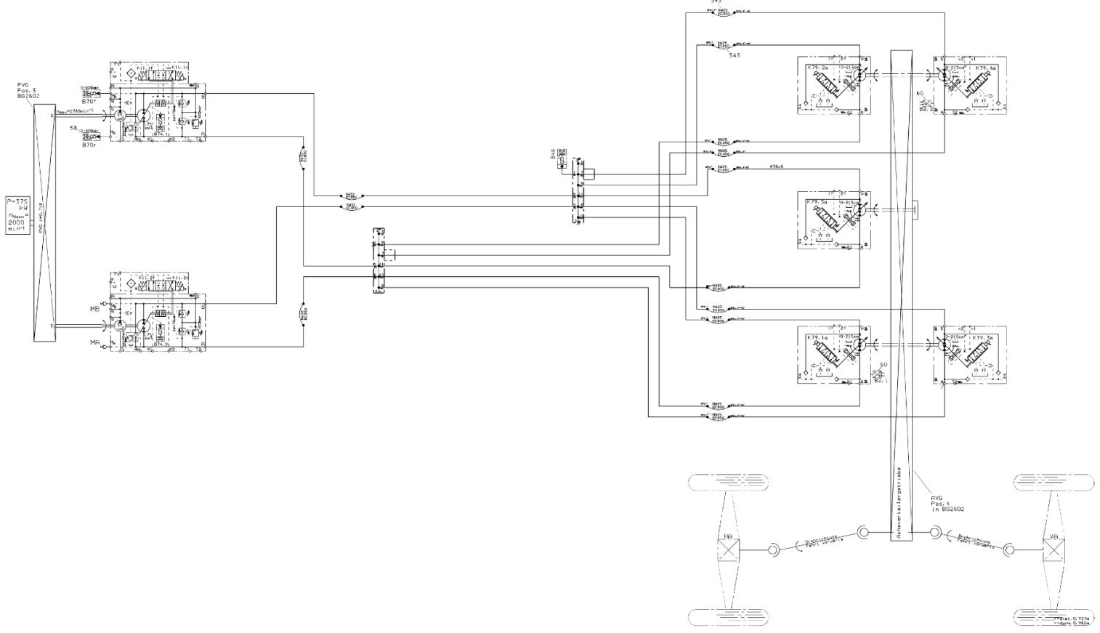
Layout Drive Unit
Pump 1
Hydraulic Motor 2
Hydraulic Motor 4
Axle Transfer Gear
Engine
Hydraulic Motor 5
Hydraulic Motor 3
Pump Transfer Gear
Hydraulic Motor 1
Pump 2
Travel Direction
Drive Shaft
Drive Unit (Layout „Sigmundshall“)
Axle Rear
Axle Front

Slide 11
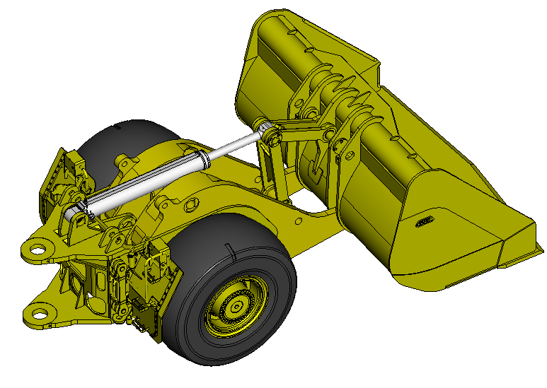
Layout Payload Unit
Connection Link (Layout LOC-matic)
Bucket (Layout LOC-matic) Capacity (SAE): 12,9 m³
1x Dump Cylinder
with Position Sensor
2x Lifting Cylinder
with Position Sensor
Work and Driving Light
Fire Extinguisher
Transport Locking Device
Payload Structure (Layout LOC-matic)
3-Point Ladder
Boom (Layout LOC-matic)
Stabilizer Link (Layout LOC-matic)

Slide 12
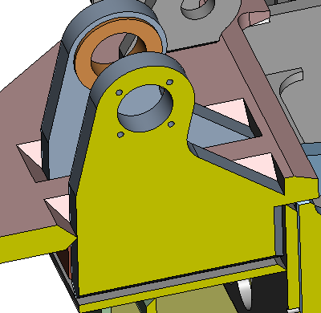
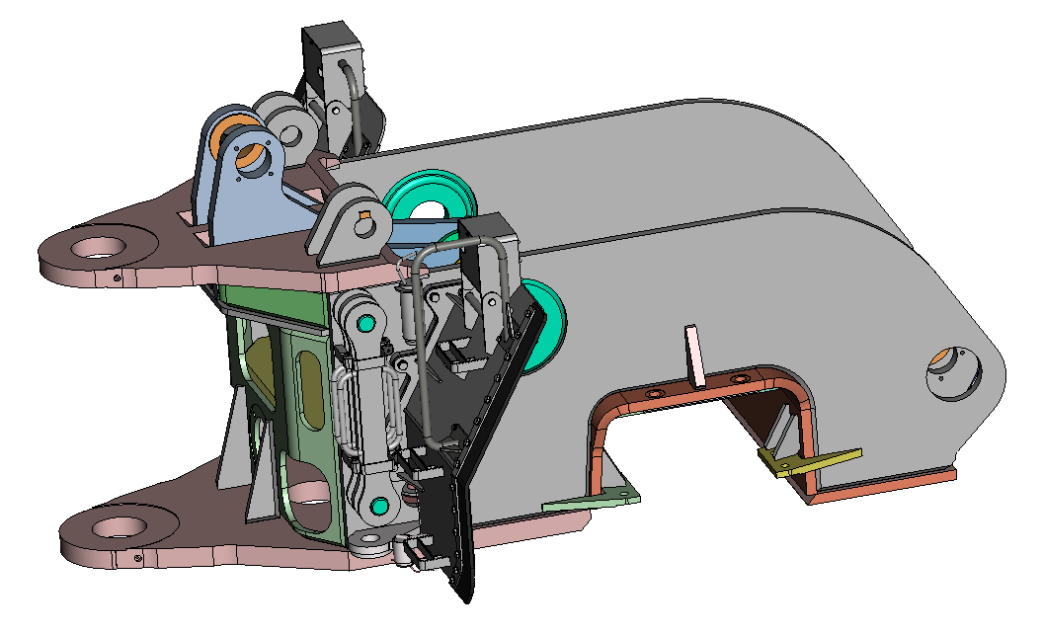
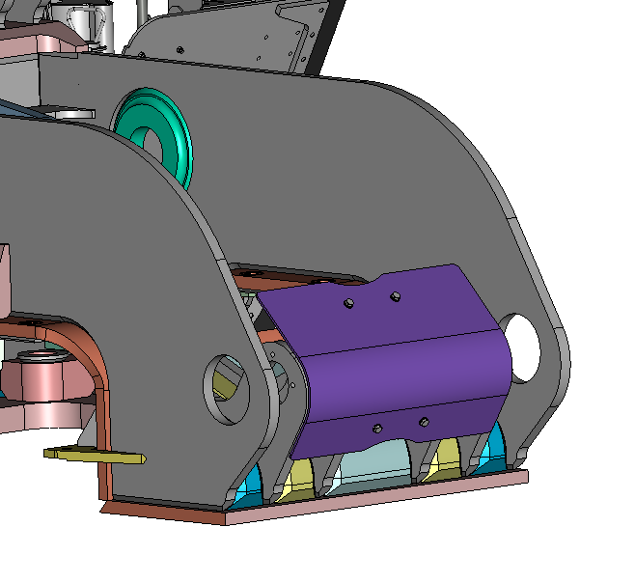
Payload Structure Improvements
welded Cylinder Bracket
improved Rock Guard
integrated Stops
(machined)
improved Welding Seam
bolted Mudguard
Rubber Protection Outside Mudguard

Slide 13
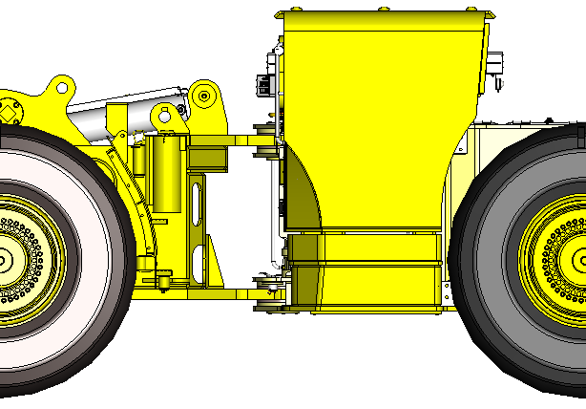
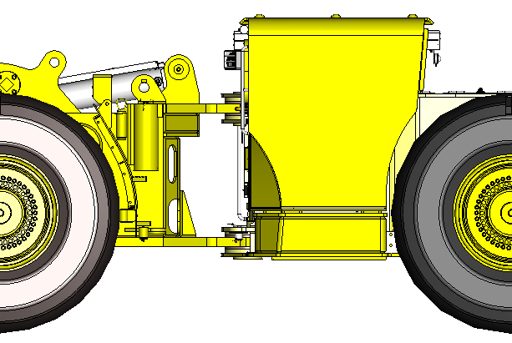
Position Operator Cabine
200 mm
200 mm
2650 mm
2850 mm
540
540
without an additional base between
overall height 2620 mm
with an additional 200mm base
overall height 2820 mm

Slide 14
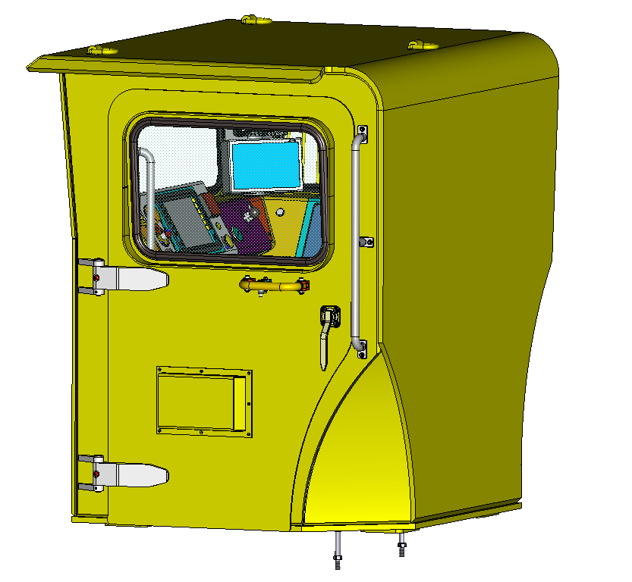
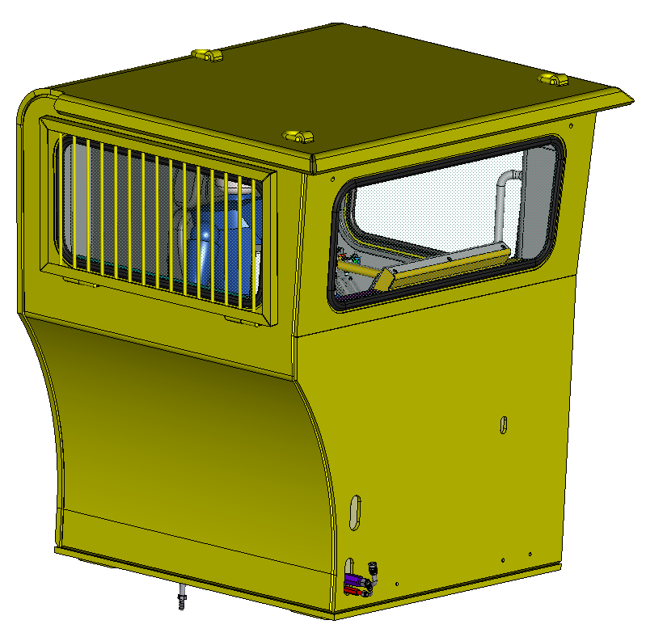
Layout Operator Cabine
Climate Cabine (Layout „Sigmundshall“)

Slide 15
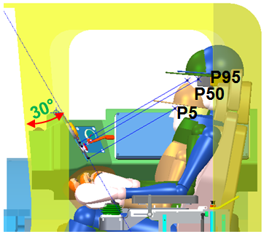
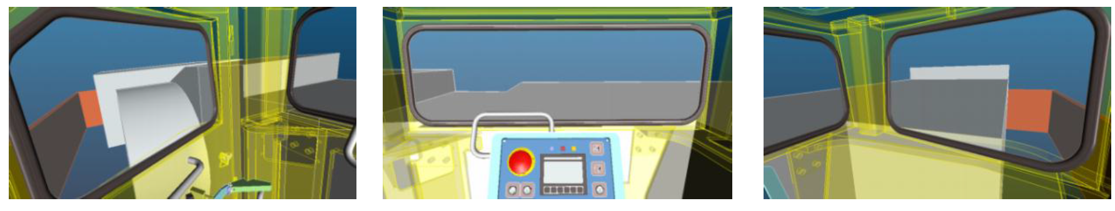
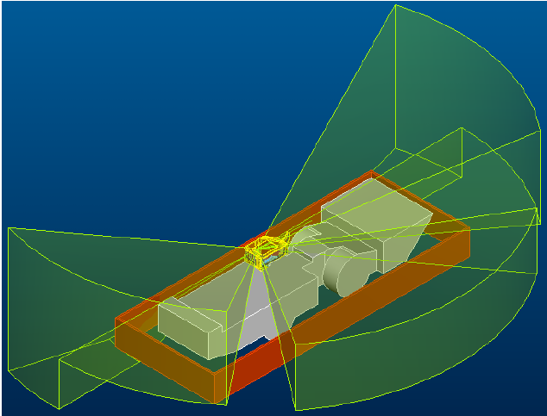
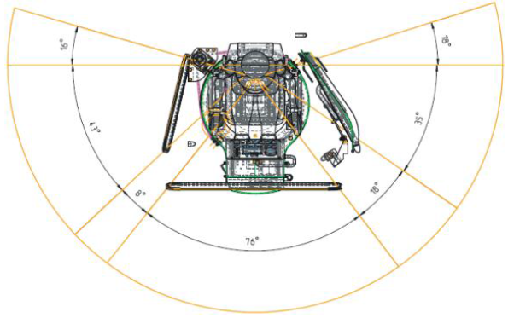
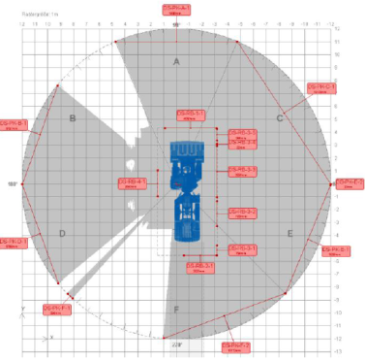
Cabine, Visual Analysis
view from operator perspective
direct view to displays
Climate Cabine (Layout „Sigmundshall“)

Slide 16
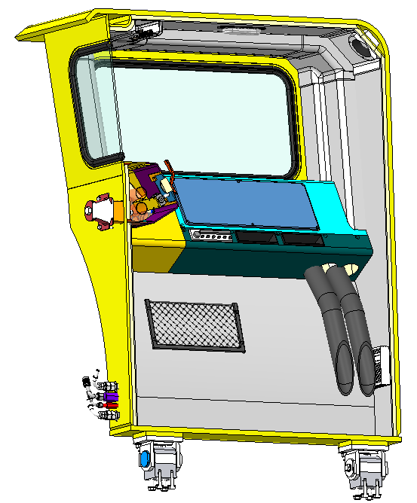
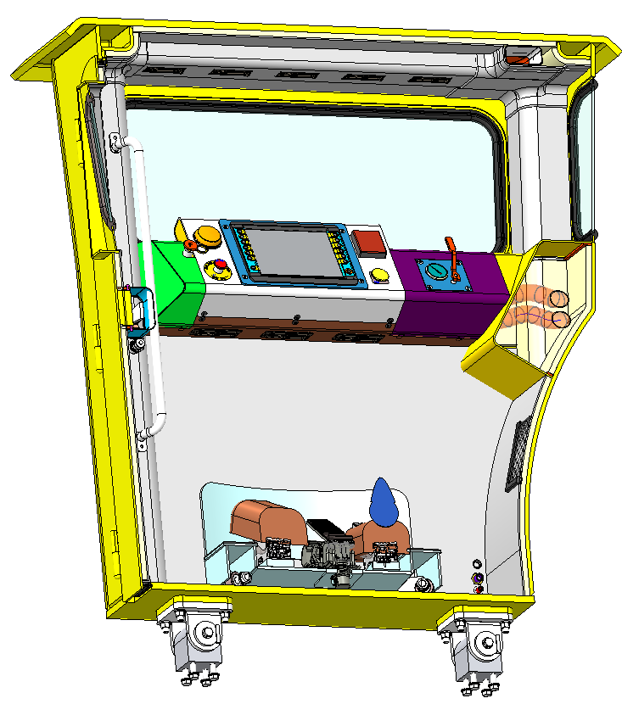
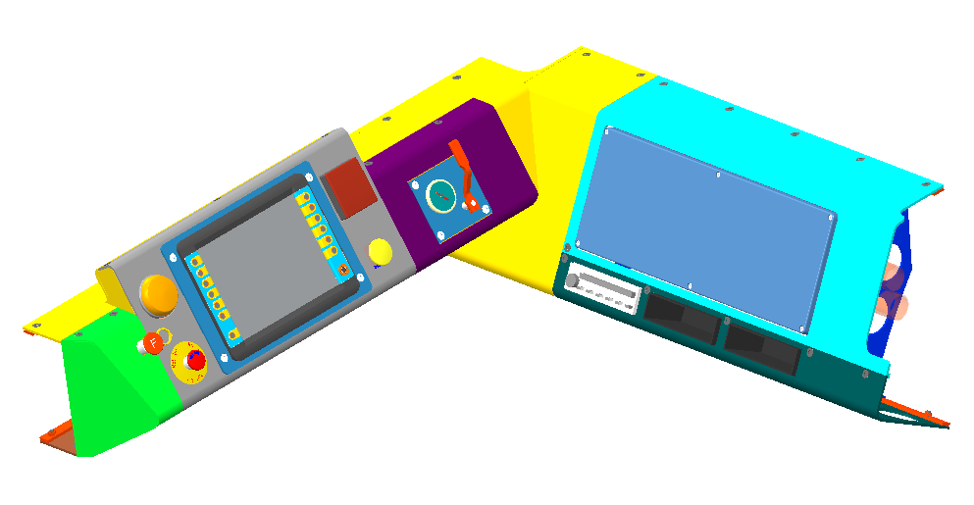
Cabine Interior
Integrated Design of Operator Panel and Interior Trim
Space for additional Display and Data Logger
Big Display
Nozzles for Air Con
(Operator and Window)
Radio Unit
manual Button for Fire-Extinguishing System
Oddments Compartment
Heat and Sound Insulation of Inside Cabine
Nozzles for Air Con
(Footwell Area)
Climate Cabine (Layout „Sigmundshall“)

Slide 17
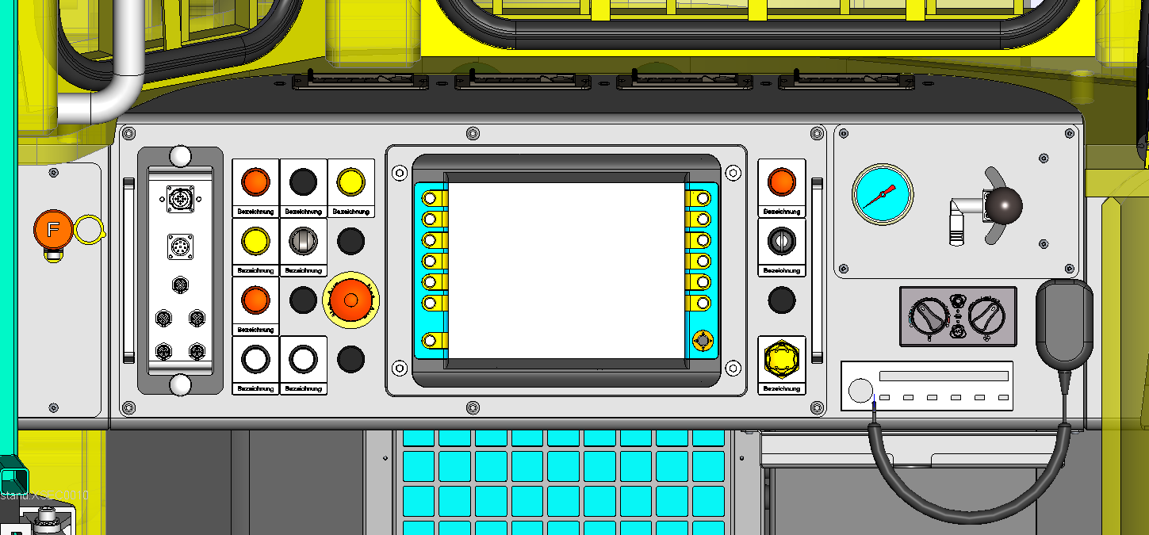
New Drivers Control Desk
Nozzles for Air Con
Emergency Stop
Signal Lampe
Parking Brake
Brake Lamp
Programming Interfaces
Keylock
manual Button for Fire-Extinguishing System
Emergency Switch Brake Valve
Big Display
Button
Seat Adjustment
Radio Unit
Signal Lamp Standby Pump

Slide 18
Technical Specification
Main Dimensions
Length 12.599 mm
Width at cabin 3.327 mm
Width at the bucket 4.000 mm
Height, laden (above drive unit) 2.235 mm
(above drivers canopy) 2.650 / 2.850 mm
Wheelbase 4410 mm
Track width 2260 mm
Steering radius (inside) 4245 ±200 mm
Steering radius (outside) 9145 ±200 mm
Weights
Deadweight approx. 79.000 kg
Payload 19.000 kg
Front-axle load, unladen approx. 29.500 kg
Rear-axle load, unladen appr ox. 30.500 kg
Tramming Capacities
Maximum tramming speed
variable from 0-22 km/h
Maximum admissible gradient 28%
Maximum tractive force 380 k N
Bucket
Bucket capacity (SAE, heaped) 12,9 m3
Break out force 250 kN
Engine
Deutz TCD 12.0 V6 Tier IV final
Output 360 kW / 2000 min -1
Pump distribution gear box
Manufacture Stiebel
Type 4399.C6
Axle distribution gear box
Manufacture Rögelberg
Type 6420-KA-5
Axles
Front axle
Manufacturer Kessler
Type D111
Design rigid planetary axles with differential
gear
Rear axle
Manufacturer Kessler
Type D111
Design rigid planetary axles with differential
gear
Swing angle ± 8°
Wheels and tires
Front wheels
Rim
Size 28.00/-33/3,5
Tires
Size 875/65R33
Rear wheels
Rim
Size 28.00/-33/3,5
Tires
Size 875/65R33
Filling volumes
Hydraulic tank 700 l
Front axle differential gear 73 l
Front axle planetary gear 2 x 14,5 l
Rear axle differential gear 73 l
Rear axle planetary gear 2 x 14,5 l
Urea tank 105 l

Slide 19
GHH Fahrzeuge GmbH
Emscherstr. 53
45891 Gelsenkirchen
Geschäftsführer / Managing Directors:
Dr. Jan Petzold
Dr. Eric Pohlmann
Tel.: +49 (0) 209 / 38 907-0
Fax: +49 (0) 209 / 38 907-109
Web: http://www.ghh-fahrzeuge.de
E-Mail: info@ghh-fahrzeuge.de

Slide 20
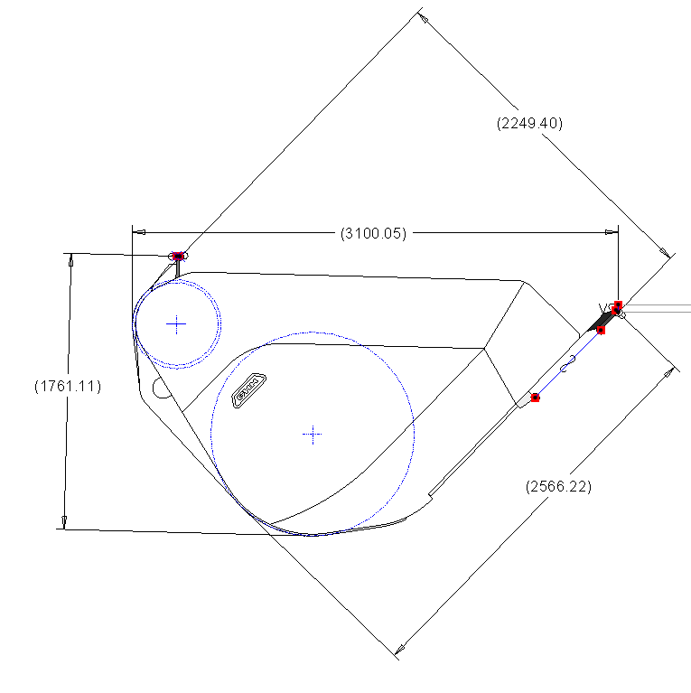
Backup
Shaft dimension Ojibway:
Length max. 1.750 mm
Width max. 1.500 mm
Heigth max. 7.600 mm
Mass max. 11.793 kg
cut

